Slide 1

The Business Model and the Business Model Canvas
Dr. Georgios Gaidajis
geogai@pme.duth.gr
Dr. Paraskeyi Gkiourka
pgiourka@gmail.com

Slide 2

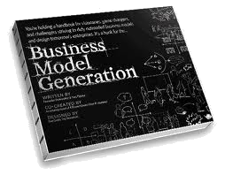
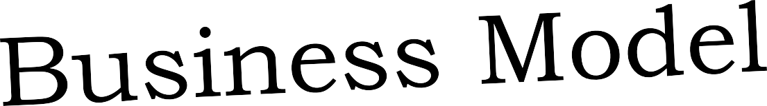


THE
Based on
Canvas

Slide 3

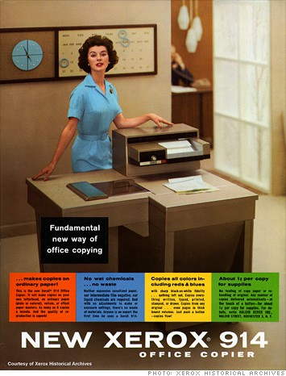
First Plain Paper Photocopier - 1950
Easy to use
No risk on originals
Ниски
Use plain paper
TOO EXPENSIVE!
to sell to customers!
Lease
$25/month
+
4¢/copy (min of $49/month)

Slide 4
business model

Slide 5
Business Model
=
an engine for creating,
delivering, and capturing value
by solving a problem
or addressing a need
Μηχανισμός δημιουργίας, παράδοσης και αποκόμισης της αξίας λύνοντας ένα πρόβλημα ή αντιμετωπίζοντας μια ανάγκη

Slide 6


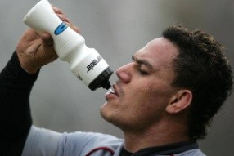




BUSINESS MODEL
Business Model
Προϊόν / Υπηρεσία
Deliver
Create
Organization
Customers
Capture
Revenue ($)

Slide 7
business model canvas

Slide 8
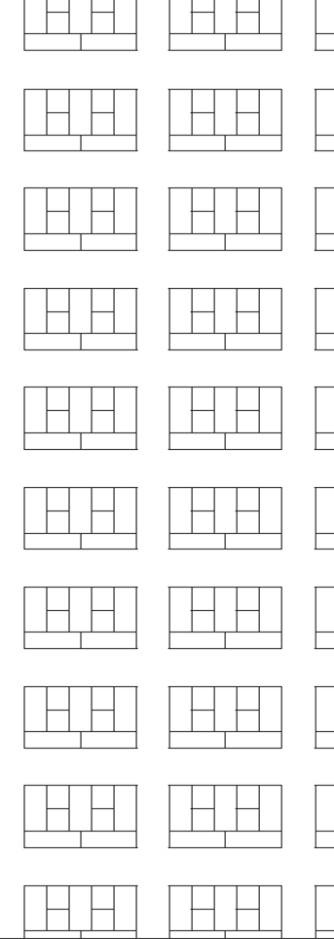
You Can
Build you business model easily
Analyse and validate existing Business Models

Slide 9
Building Blocks

Slide 10
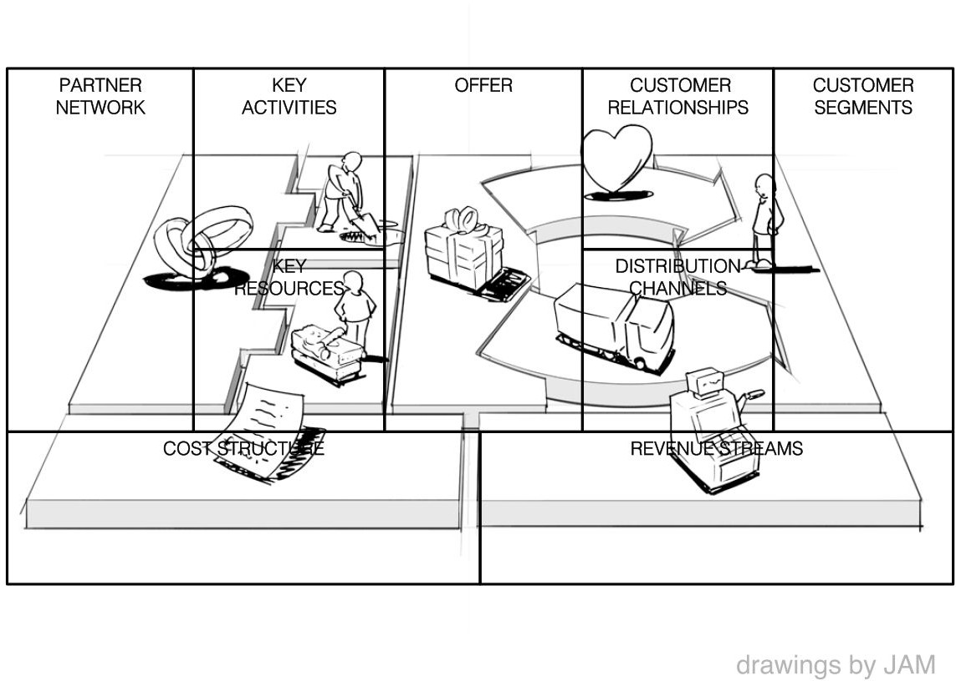
Business Model Canvas

Slide 11
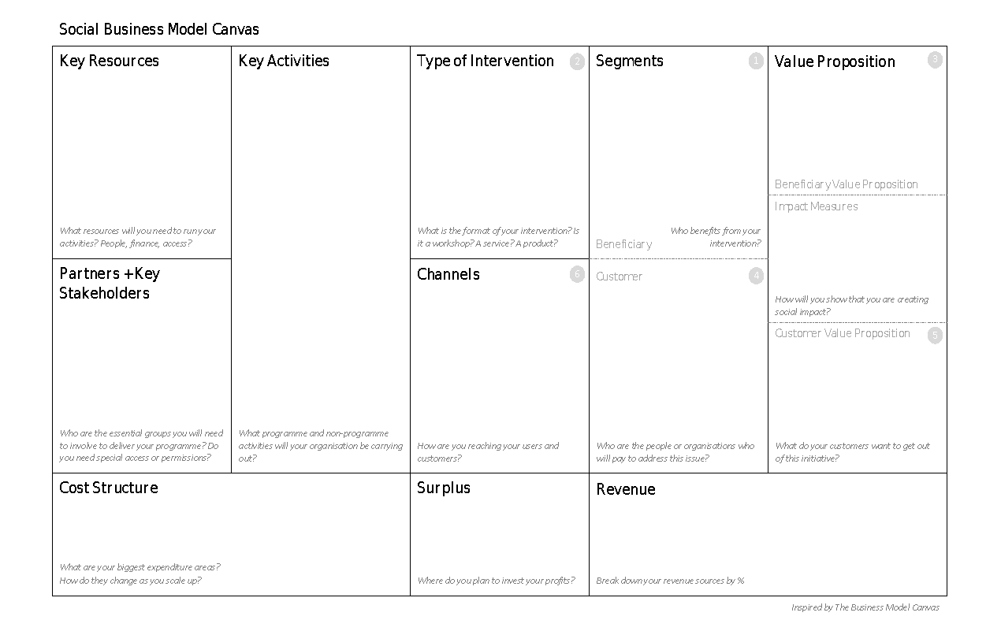
Non-Profit, Not-for-Profit, ”B” / Social Benefit, Social Purpose, For-Profit
Business Model Canvas:
A toolbox
for planning your enterprise,
and the Value
produced
Deliver
Create
Capture

Slide 12
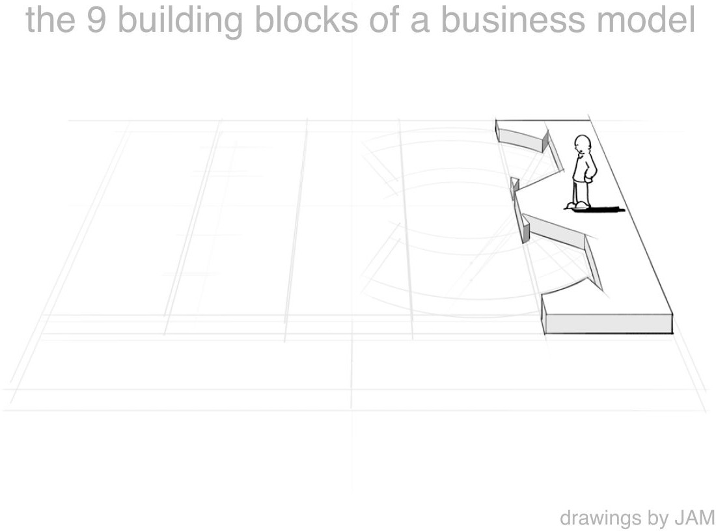
Customer Segments
which customers and users are you serving? which jobs do they really want to get done?

Slide 13
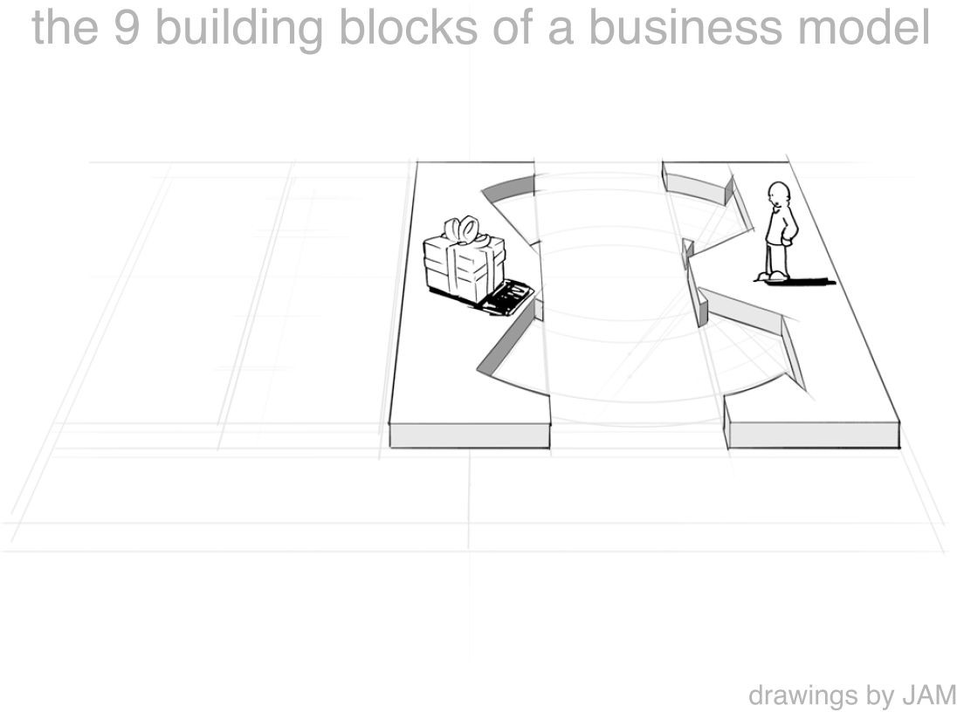
Value Proposition
what are you offering them? what is that getting done for them? do they care?

Slide 14
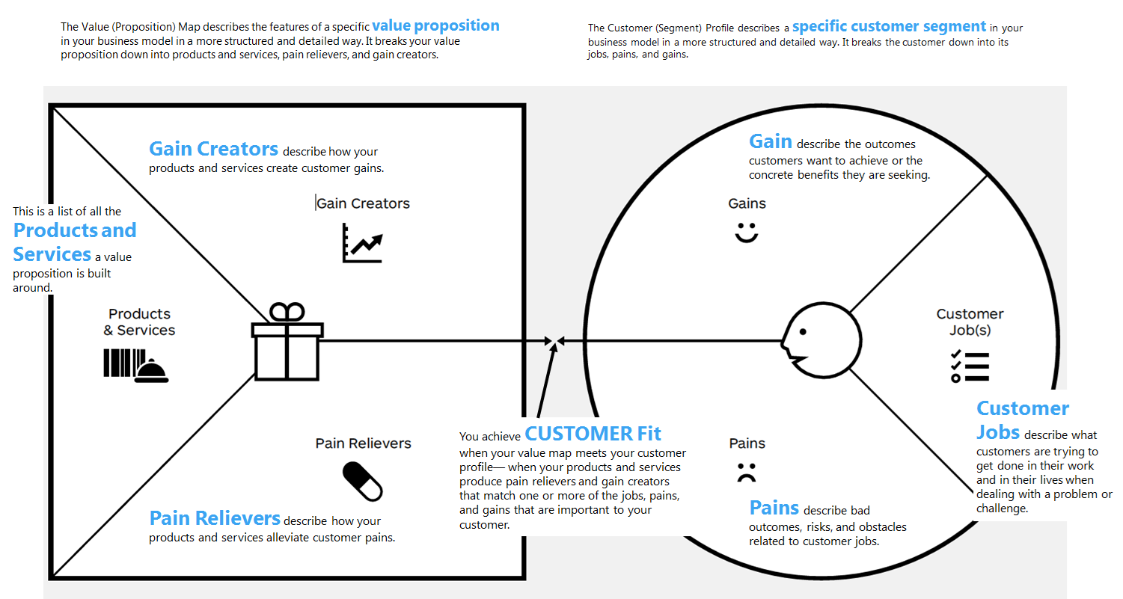
The Value Proposition Map
Test - Measure - Learn
WHAT?
WHY?
DESIGN
Product – Market Fit!!!
OBSERVE

Slide 15
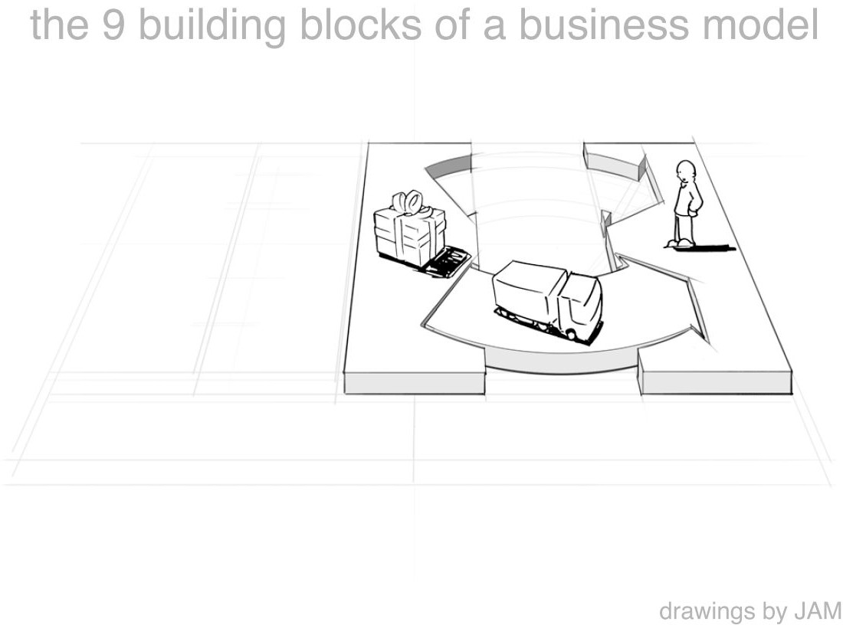
Channels
how does each customer segment want to be reached? through which interaction points?

Slide 16
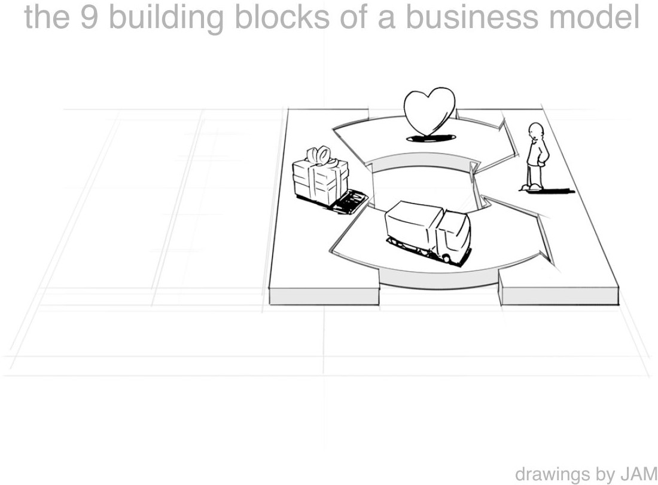
Customer Relationships
what relationships are you establishing with each segment? personal? automated? acquisitive? retentive?

Slide 17
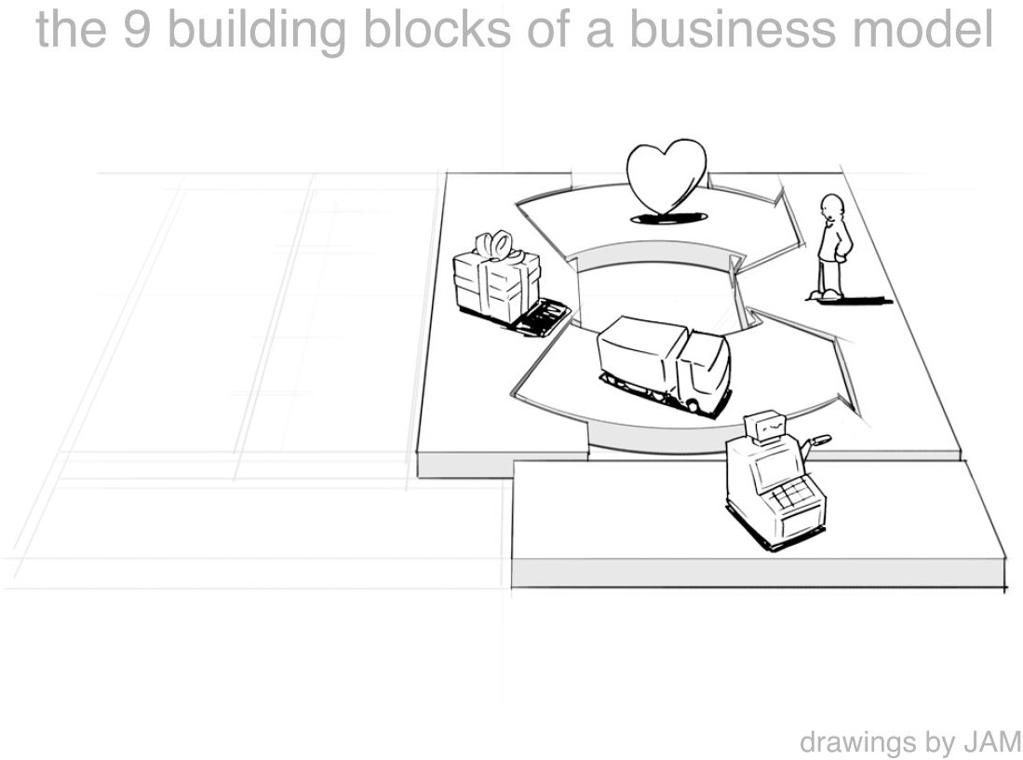
Revenue Streams
what are customers really willing to pay for? how?
are you generating transactional or recurring revenues?

Slide 18
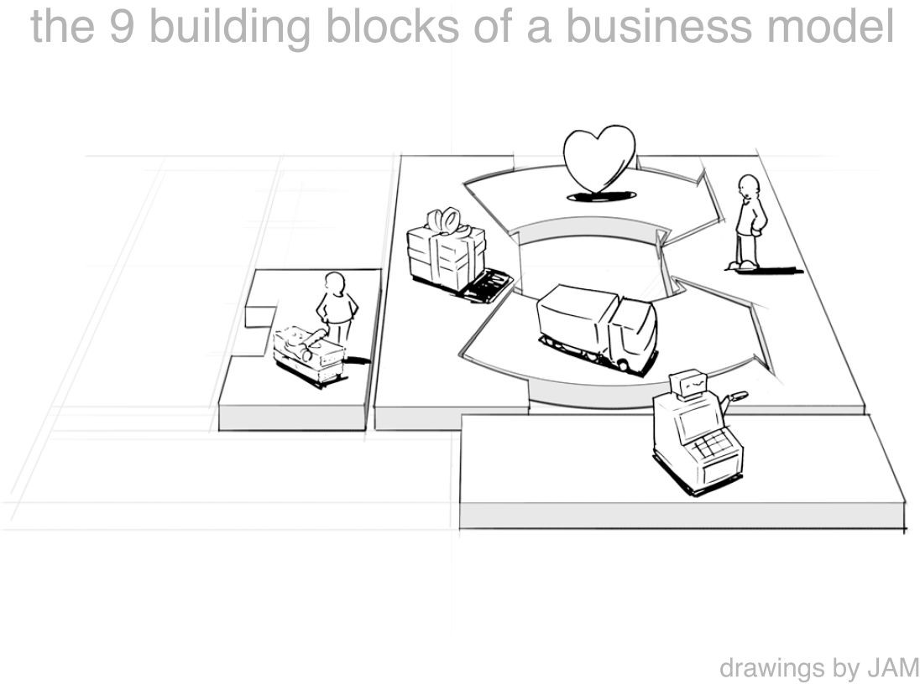
Key Resources
which resources underpin your business model? which assets are essential?

Slide 19
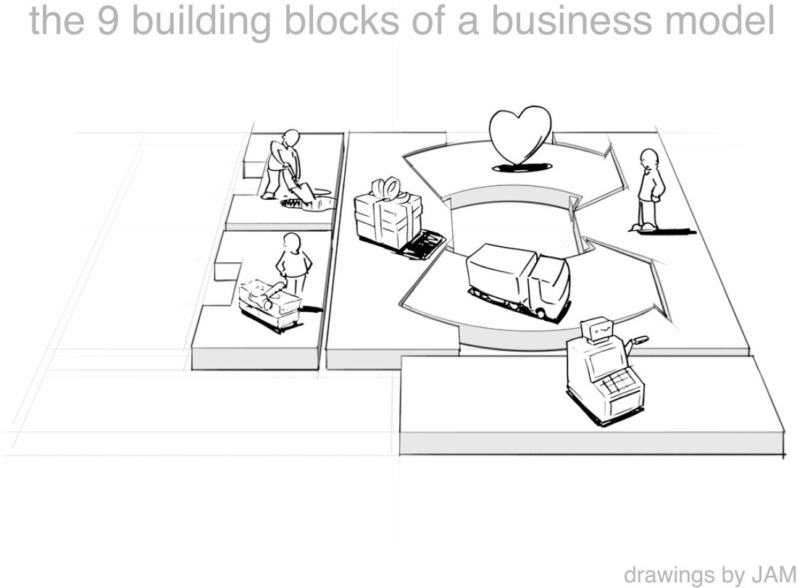
Key Activities
which activities do you need to perform well in your business model? what is crucial?

Slide 20
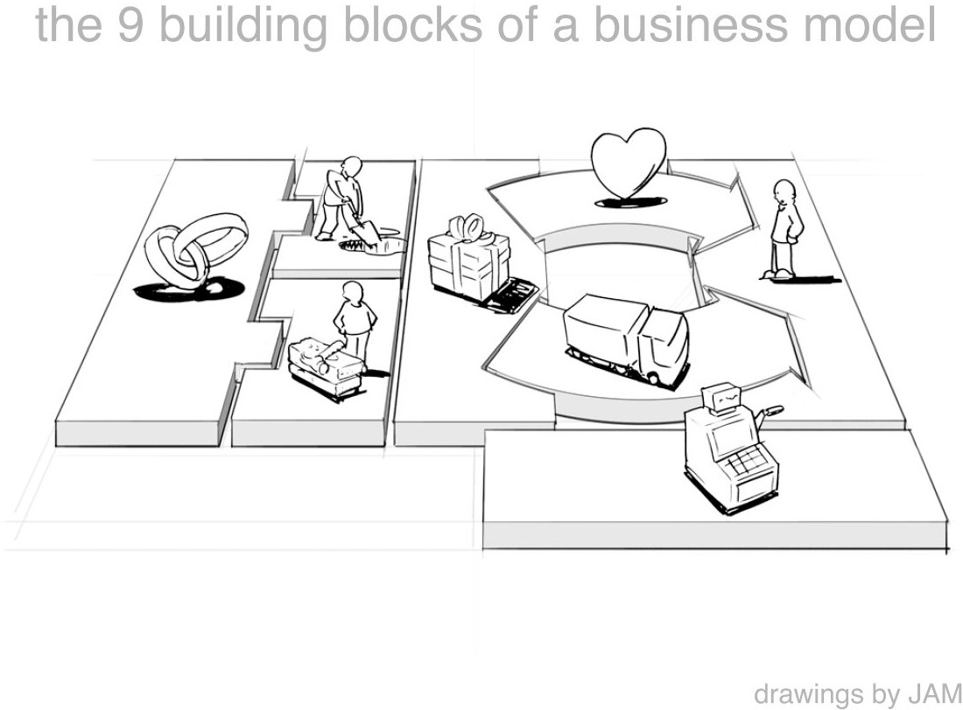
Key Partners
which partners and suppliers leverage your model? who do you need to rely on?

Slide 21
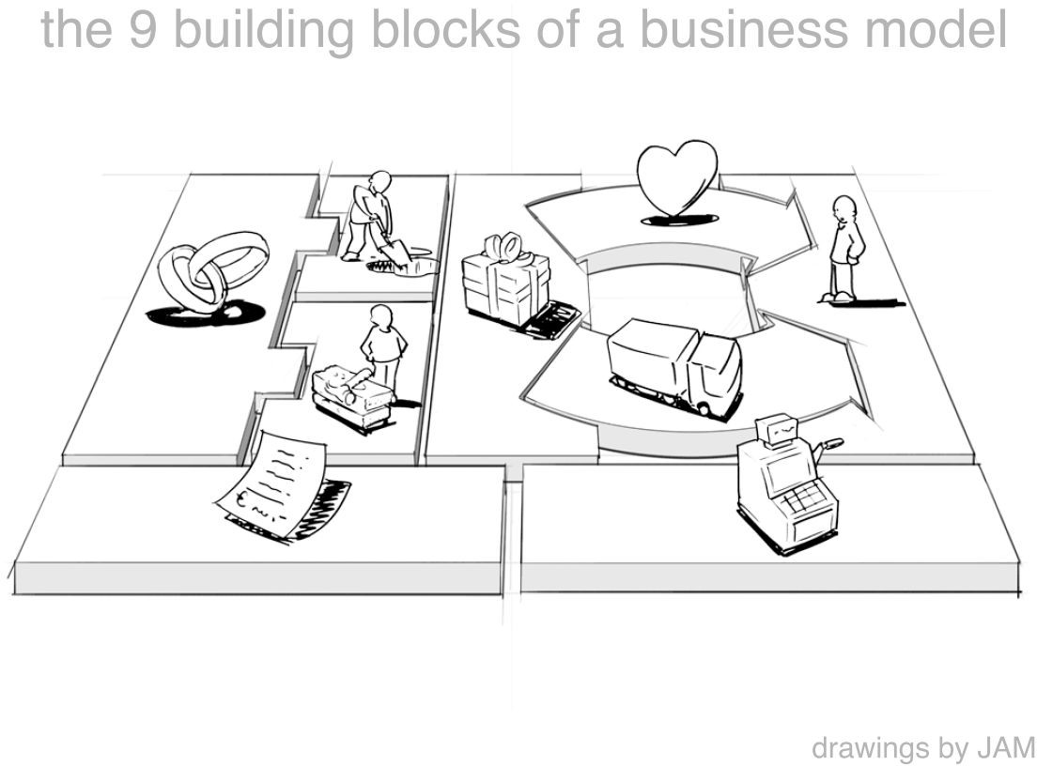
Cost Structure
what is the resulting cost structure? which key elements drive your costs?

Slide 22
Business Model Canvas

Slide 23

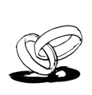
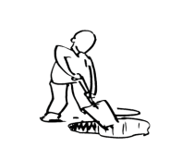


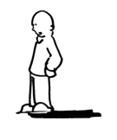























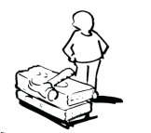
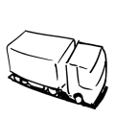










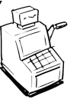












Your Business Model Canvas
KEY PARTNERS | KEY ACTIVITIES | VALUE PROPOSITION |  | RELATIONSHIPS | CUSTOMER SEGMENT
 | KEY RESOURCES
 |  |  |  | CHANNELS
COST STRUCTURE |  |  | REVENUE STREAMS 20

Slide 24
What’s wrong with my canvas?
Wrong start – wrong end
The Business Model Canvas is solution-driven (value proposition) rather than market pain-centric. It assumes that the stated Value Proposition IS the desired solution resolving the pain of the stated targeted customer.
But what if the solution built around it is wrong?

Slide 25
What’s wrong with my canvas?
Solving Bigger Problems
Founders can identify the problem and opportunity but end up planning too big for Minimum Viable Product (MVP) standards
Is your canvas trying to depict an intergalactic implementation?

Slide 26
What’s wrong with my canvas?
Learning from Mistakes? Nope
The canvas design omits the
Measure – Learn – Elimination
aspect. It Is more a snapshot type of a tool
What if you fail on accounting for… fails?

Slide 27
What’s wrong with my canvas?
It’s not a shopping list
Most of the times startup teams/companies fail to recognize the BMC process of analysing to determine needs in each category.
In that token they treat the canvas as a check list
Have you investing in adequate research and enough time + brainpower?

Slide 28
What’s wrong with my canvas?
Too simple vs too detailed
It’s hard to have the right balance in the depicted info. It’s better though, to start with enough detail in the beginning and later refine by using less words
It’s always better to slash and burn what you don’t need instead of assuming a lot from the get-go.

Slide 29


you need to validate your model assumptions with the customers until you get it right!
29

Slide 30
How to validate?
There are three clever ways to validate these assumptions and to talk directly to customers:
Conduct market research.
Talk to customers about the pain points and demonstrate how your solution works (create a Minimum Viable Product for this).
Receive feedback and use it as validation through queries, interviews and surveys (use survey sites, landing pages, and cold calling).

Slide 31
Examples
31

Slide 32
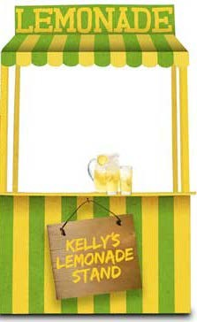
Example 1
Example 2
TOMS
Refreshing lemonade to joggers at public parks
“For every product sold,
we help a person in need”
32

Slide 33





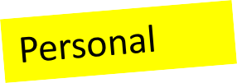
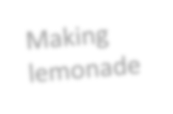
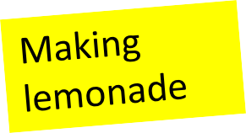
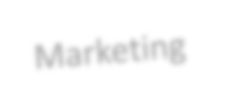

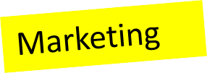



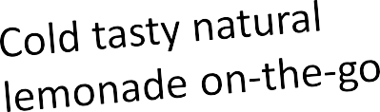

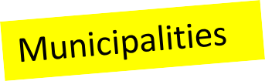
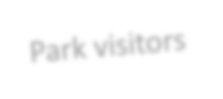


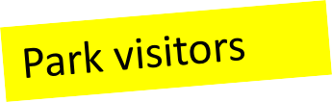

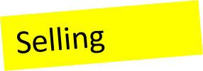


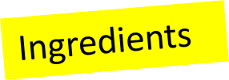



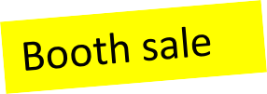

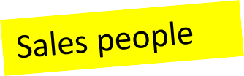
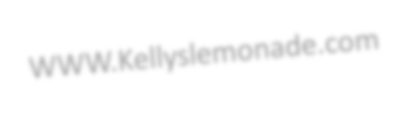


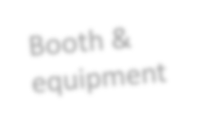
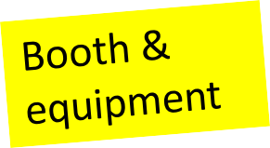

















Kelly’s Lemonade Stand: Refreshing Lemonade
KEY PARTNERS
KEY ACTIVITIES
VALUE RELATIONSHIPS PROPOSITION
CUSTOMER SEGMENT
KEY RESOURCES
CHANNELS
COST STRUCTURE
REVENUE STREAMS
33

Slide 34




















































Skype
KEY PARTNERS | KEY ACTIVITIES | VALUE PROPOSITION |  | RELATIONSHIPS | CUSTOMER SEGMENT
 | KEY RESOURCES
 |  |  |  | CHANNELS
COST STRUCTURE |  |  | REVENUE STREAMS 24

Slide 35

www.BusinessModelGeneration.com
35

Slide 36
THANK YOU!
Paraskevi Giourka, PhD
Innovation and Business Strategist
pgiourka@gmail.com
36

