Slide 1

Financial Planning and Sources of Funding
Dr. Georgios Gaidajis
geogai@pme.duth.gr
Dr. Paraskeyi Gkiourka
pgiourka@gmail.com

Slide 2
Not just numbers but rather the reflection of your thoughts, goals and strategy
Financial Planning

Slide 3
Budgeting is a critical process as it makes an entrepreneur put down thoughts and (hopefully) test their reality in various dimensions (pricing, demand, supply, human and other resources, volatility, capital needs) with a financial projection
Better have a bad budget than no budget at all*

Slide 4
Income is money that a business receives in exchange for providing a good or service or through investing capital.
Cost of goods sold (COGS) are the costs of acquiring or manufacturing the products that a company sells during a period, and in specific those that are directly tied to the production of the products, including the cost of labor, materials, and manufacturing overhead
Operating costs are expenses associated with the maintenance and administration of a business on a day-to-day basis. They are the cost of resources used by an organization just to maintain its existence (operations).
EBITDA: Earnings before interest, tax, depreciation and amortization (EBITDA) is a measure of a company's operating performance. EBITDA is a way to evaluate a company's performance.
Cash flow is the net amount of cash and cash-equivalents being transferred into and out of a business. A cash flow in its narrow sense is a payment; the term 'cash flow' is mostly used to describe payments that are expected to happen in the future as a form of forecast.
Some Basics……..

Slide 5
Founders start with vague projections over the years, showing early profits and forgetting cash-flow aspects
Putting together a full financial plan is a challenge
Plans are too simple limiting financial vision thus increasing entrepreneurial and investment risks

Slide 6
Cost Prototypes and average Product Cost (design/creation/materials/know- how)
Phase 1 of planning
Production Budget
Estimate demand
Try to quantify the market’s size and the market share you wish to get over time
Price your product – service mix addressing your Minimum Viable Segment for introductory and follow- on periods (3-5 years)

Slide 7
Project Sales over-time per product/service type
Cost your production that will provide the necessary products and services that you forecasted
Phase 2 of planning
Sales Budget

Slide 8
Design and cost a HR plan forecasting needs to support cost of production and operations
Phase 3 of planning
HR Budget
(Make it analytical as it will be a critical element absorbing enough monetary resources)

Slide 9
Now it’s time to add your operating
expenses to the picture
Phase 4 of planning
Operations Budget
Add any financial costs (loan payments and taxation projections)

Slide 10
Generate a cash-flow per month and
for each year of your forecast
Phase 5 of planning
Cash Flow
Identify your break-even from a) sales and b) cash-flow

Slide 11
Having all the aspects together identify the total capital needs and breakdown
E.g. 200.000 euros for 3 years
20% Product Development
30% Business Development
30% Marketing
20% Other Operating Costs
Phase 6 of planning
Capital Needs

Slide 12
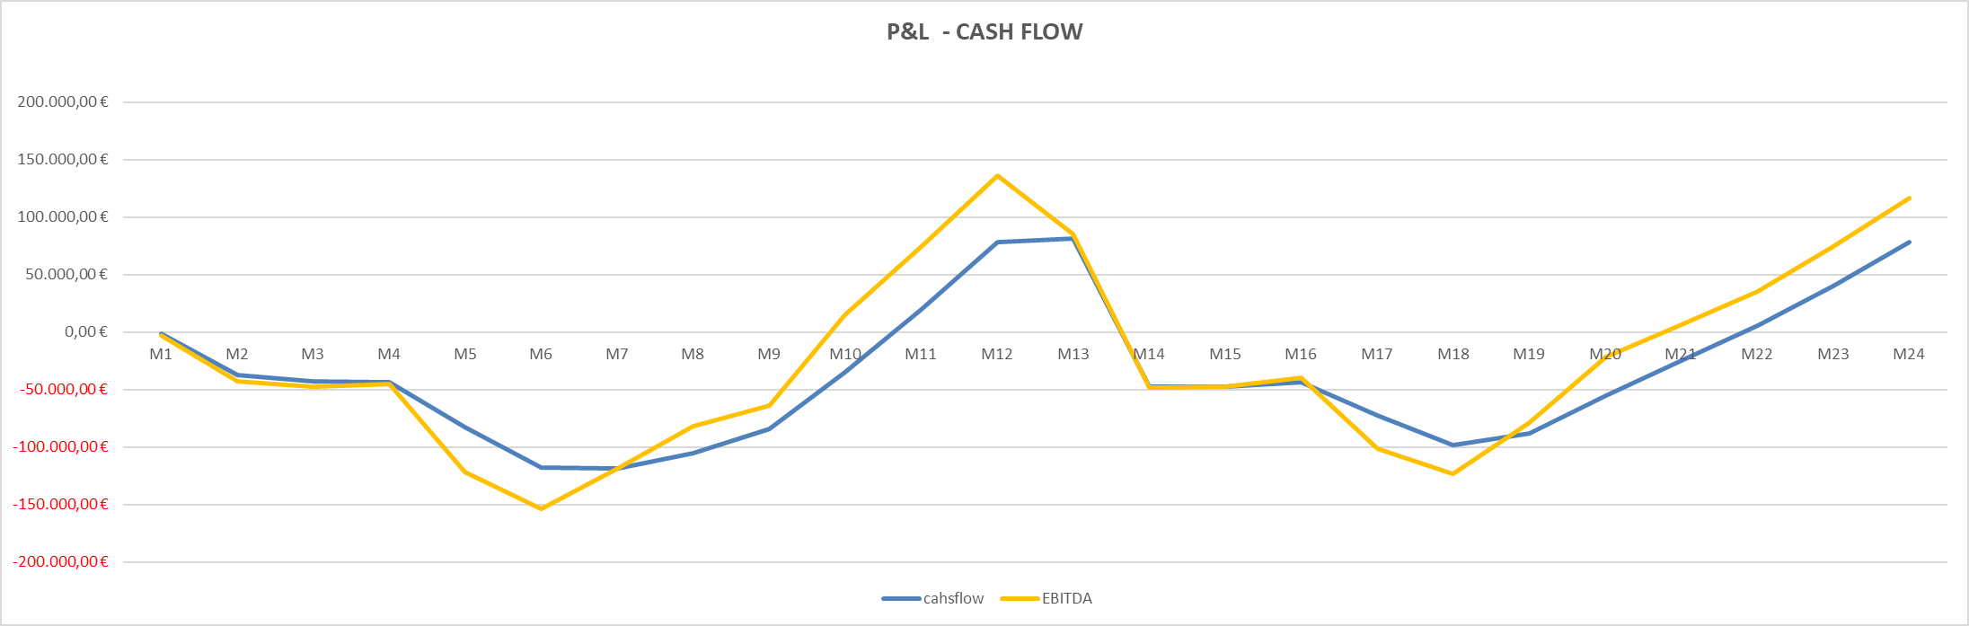
Cash Flow
P&L

Slide 13
Phase 7 of planning
Explore what sources of funding are available
Decide what methods of funding
are the right for you (Bootstrapping,
3F’s, Loan, Grant, Equity
Investment)
…before act, think again before you take the next step

Slide 14
Α. Traditional Funding Sources
a) Working Capital Loans are aimed at improving the liquidity of the business and tο provide immediate coverage of operational or any emergency needs, and they are of short duration.
b) Long Term Loans usually include Facility Loans and Professional Equipment Loans. The interest rate of these loans is low compared to the corresponding interest rate of working capital loans mainly because in long-term loans the repayment period is long
1. Bank Loans
Πηγή: https://kalo.gov.gr/wp-content/uploads/2019/05/11.-%CE%9C%CE%9F%CE%A1%CE%A6%CE%95%CE%A3-%CE%A7%CE%A1%CE%97%CE%9C%CE%91%CE%A4%CE%9F%CE%94%CE%9F%CE%A4%CE%97%CE%A3%CE%97%CE%A3-%CE%A0%CE%9F%CE%9B%CE%A5-%CE%9C%CE%99%CE%9A%CE%A1%CE%A9%CE%9D-%CE%9C%CE%9C%CE%95.pdf

Slide 15
Α. Traditional Funding Sources
Microfinance as a source of raising capital has existed in different forms for centuries and may be considered a relatively traditional form of financing, however, it is now one of the most important types of financing for very small and early-stage businesses (start-ups), especially in developing economies.
Greek Law 4701/2020 on microfinance for up to 25,000 euros for the unemployed and businesses without guarantees
2. Microfinancing
Πηγή: https://kalo.gov.gr/wp-content/uploads/2019/05/11.-%CE%9C%CE%9F%CE%A1%CE%A6%CE%95%CE%A3-%CE%A7%CE%A1%CE%97%CE%9C%CE%91%CE%A4%CE%9F%CE%94%CE%9F%CE%A4%CE%97%CE%A3%CE%97%CE%A3-%CE%A0%CE%9F%CE%9B%CE%A5-%CE%9C%CE%99%CE%9A%CE%A1%CE%A9%CE%9D-%CE%9C%CE%9C%CE%95.pdf
Notes:
Κατατίθεται αυτές τις μέρες στη Βουλή νομοσχέδιο, με το οποίο η κυβέρνηση επιχειρεί να δοθεί η ευκαιρία και η πρόσβαση σε μικροχρηματοδοτήσεις με νόμιμους όρους για χιλιάδες μικρές επιχειρήσεις οι οποίες δεν έχουν πρόσβαση σε τραπεζικό δανεισμό.Στόχος του νομοσχεδίου είναι μικροχρηματοδοτήσεις να δοθούν σε όσους τις δικαιούνται μέσω τρίτων νέων πηγών, οι οποίες θα δώσουν “ανάσα” σε όσους αντιμετωπίζουν προβλήματα από την κρίση που αφήνει πίσω του ο νέος κορωνοϊός, αλλά είναι αποκλεισμένοι από τις επίσημες τραπεζικές οδούς.
Έως 25.000€ και χωρίς εγγυήσεις μικροχρηματοδοτήσεις
Οι μικροχρηματοδοτήσεις θα διακρίνονται σε δύο κατηγορίες, τις επιχειρηματικές και τις προσωπικές. Οι επιχειρηματικές μπορεί να έχουν τα εξής χαρακτηριστικά:
Όλες οι μορφές πιστώσεων έως 25.000 ευρώ που χορηγούνται είτε για την κάλυψη επενδυτικών αναγκών είτε ως κεφάλαιο κίνησης
Προϊόντα χρηματοδοτικής μίσθωσης έως 25.000 ευρώ για την απόκτηση εξοπλισμού
Αυτοτελείς εγγυήσεις έως 25.000 ευρώ, οι οποίες δεν μπορεί να χρησιμοποιηθούν για τη λήψη δανείων από άλλα χρηματοδοτικά ιδρύματα
Δικαιούχοι των επιχειρηματικών μικροχρηματοδοτήσεων μπορεί να είναι πολύ μικρές επιχειρήσεις, φυσικά πρόσωπα για τη σύσταση πολύ μικρών επιχειρήσεων, ελεύθεροι επαγγελματίες ή αυτοαπασχολούμενοι και φορείς κοινωνικής και αλληλέγγυας οικονομίας.
Τα δάνεια αυτά θα δίνονται χωρίς την υποχρέωση εμπράγματων εξασφαλίσεων από πλευράς δανειοληπτών. Οι δραστηριότητες που θα καλύπτουν οι μικροχρηματοδοτήσεις έως 25.000 ευρώ θα αφορούν ανάγκες για επενδύσεις ή για κεφάλαιο κίνησης, ανάγκες εξοπλισμού ή μίσθωσης, εγγυήσεις, ακόμα και κόστη εκπαίδευσης. Το ευρύ φάσμα των καλυπτόμενων δραστηριοτήτων περιλαμβάνει τόσο μικροεπαγγελματίες που αδυνατούν να συνεχίσουν τη δραστηριότητά τους χωρίς νέα χρηματοδότηση, όσο και ανέργους που θέλουν να ενταχθούν στην οικονομική παραγωγή. Ο θεσμός των μικροχρηματοδοτήσεων αναμένεται ότι θα συνοδευτεί από την παροχή φορολογικών κινήτρων στους δικαιούχους (έκπτωση τόκων, απαλλαγή από χαρτόσημα).

Slide 16
All forms of credit up to 25,000 euros granted either to cover investment needs or as working capital.
Financial leasing up to 25,000 euros for the acquisition of equipment.
Self-guarantees up to 25,000 euros, which cannot be used to obtain loans from other financial institutions.
Beneficiaries of business microfinance can be very small businesses, natural persons for the establishment of very small businesses, freelancers or self-employed and social and solidarity economy operators.
2. Microfinancing
Πηγή: https://kalo.gov.gr/wp-content/uploads/2019/05/11.-%CE%9C%CE%9F%CE%A1%CE%A6%CE%95%CE%A3-%CE%A7%CE%A1%CE%97%CE%9C%CE%91%CE%A4%CE%9F%CE%94%CE%9F%CE%A4%CE%97%CE%A3%CE%97%CE%A3-%CE%A0%CE%9F%CE%9B%CE%A5-%CE%9C%CE%99%CE%9A%CE%A1%CE%A9%CE%9D-%CE%9C%CE%9C%CE%95.pdf

Slide 17
1. Venture Capital
Β. Alternative Funding Sources
A venture capital (VC) is a private equity investor that provides capital to companies with high growth potential in exchange for an equity stake. This could be funding startup ventures or supporting small companies that wish to expand but do not have access to equities markets.
Πηγή: https://kalo.gov.gr/wp-content/uploads/2019/05/11.-%CE%9C%CE%9F%CE%A1%CE%A6%CE%95%CE%A3-%CE%A7%CE%A1%CE%97%CE%9C%CE%91%CE%A4%CE%9F%CE%94%CE%9F%CE%A4%CE%97%CE%A3%CE%97%CE%A3-%CE%A0%CE%9F%CE%9B%CE%A5-%CE%9C%CE%99%CE%9A%CE%A1%CE%A9%CE%9D-%CE%9C%CE%9C%CE%95.pdf

Slide 18
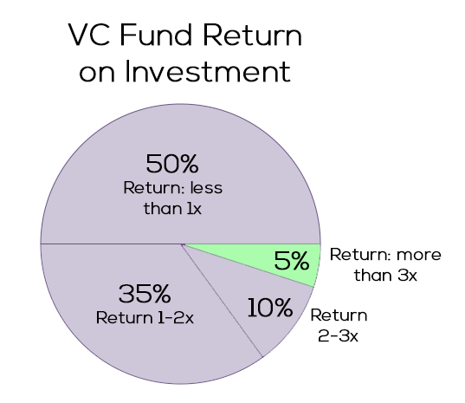
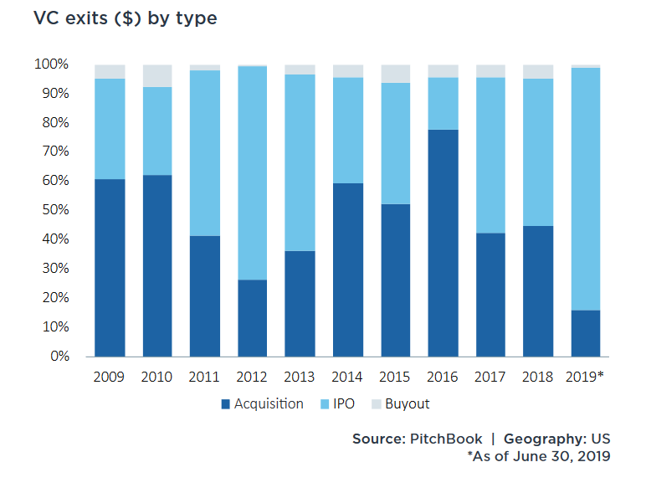
VC’s Performance
Source: PitchBook
Source: Techcrunch

Slide 19
2. Leasing
Leasing is a very easy way for modern businesses to be financed regardless of their size.
Through leasing businesses can acquire facilities or technological equipment without having to commit their funds.
Πηγή: https://kalo.gov.gr/wp-content/uploads/2019/05/11.-%CE%9C%CE%9F%CE%A1%CE%A6%CE%95%CE%A3-%CE%A7%CE%A1%CE%97%CE%9C%CE%91%CE%A4%CE%9F%CE%94%CE%9F%CE%A4%CE%97%CE%A3%CE%97%CE%A3-%CE%A0%CE%9F%CE%9B%CE%A5-%CE%9C%CE%99%CE%9A%CE%A1%CE%A9%CE%9D-%CE%9C%CE%9C%CE%95.pdf

Slide 20
Leasing products:
Financial Leasing (classic):
Fixed Equipment Leasing.
Real Estate Leasing.
Sale & Lease Back Properties. – The sale and lease back enables the business to take advantage of significant funds that remain tied up in fixed assets. Essentially, it is a tool for refinancing the fixed assets owned by the company.
Sale & Lease Back Equipment. – Operating Leasing (mainly concerns cars).
2. Leasing
Leasing is the form of financing of fixed equipment, where a leasing company buys the asset indicated by the customer (the business) and then the leasing company leases the asset to the business for a monthly or quarterly rent. It is also agreed whether or not the asset will be purchased by the company at the end of the lease at a pre-agreed value.

Slide 21
1. Business Angels
C. Modern Trends in Forms of Financing
"Angel investors" are financially sound individuals who invest in high-quality ventures in exchange for an equity stake.
They are private investors, who invest money and have time, experience and know-how in small and medium-sized enterprises, which show growth prospects and are usually people with experience in business management and organization and marketing.
They come in the first phase of the company's development and are smart funds.
Πηγή: https://kalo.gov.gr/wp-content/uploads/2019/05/11.-%CE%9C%CE%9F%CE%A1%CE%A6%CE%95%CE%A3-%CE%A7%CE%A1%CE%97%CE%9C%CE%91%CE%A4%CE%9F%CE%94%CE%9F%CE%A4%CE%97%CE%A3%CE%97%CE%A3-%CE%A0%CE%9F%CE%9B%CE%A5-%CE%9C%CE%99%CE%9A%CE%A1%CE%A9%CE%9D-%CE%9C%CE%9C%CE%95.pdf

Slide 22
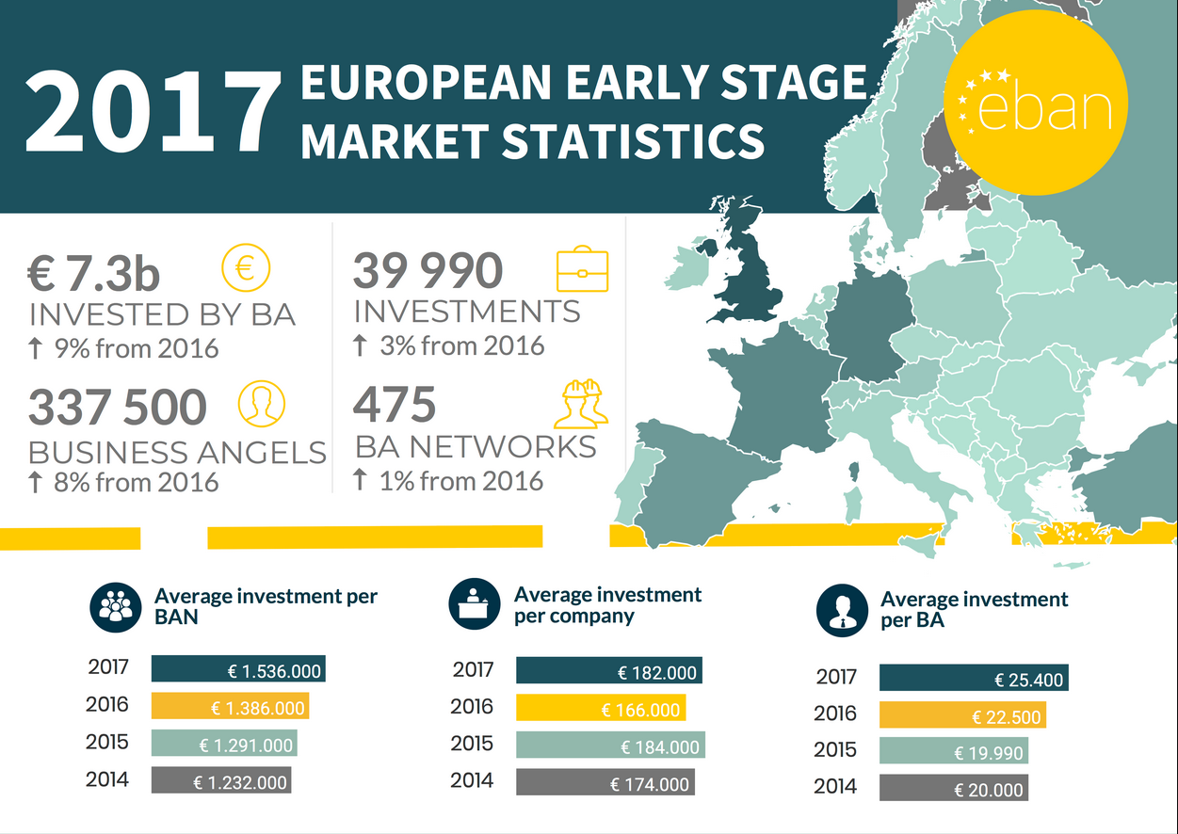
Early stage investments in Europe continue to increase on a quarterly average. In Q1 2015, BA's investments exceeded 400 Million (EUR), while in Q2 2018, this amount reached 2 Billion (EUR) for the quarter.

Slide 23
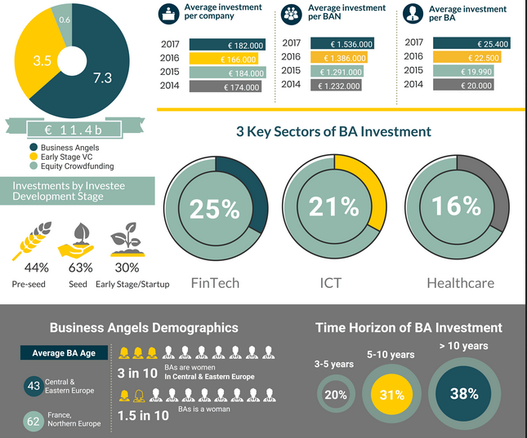

Slide 24
2. Θερμοκοιτίδες επιχειρήσεων (Business Incubators)
2. Incubators
Business Incubators are companies that grant start-ups with fast growth prospects:
supporting functions, financing (to a lesser extent than the corresponding one offered by VCs),
business premises and equipment (such as building facilities, furniture, computers, telephones, internet access),
secretarial support services,
consulting services and support (such as in matters of taxation, accounting, legal, IT, staffing),
network of contacts with customers and suppliers
and in return receives a percentage of the share capital and/or payments from the newly established company.
Πηγή: https://kalo.gov.gr/wp-content/uploads/2019/05/11.-%CE%9C%CE%9F%CE%A1%CE%A6%CE%95%CE%A3-%CE%A7%CE%A1%CE%97%CE%9C%CE%91%CE%A4%CE%9F%CE%94%CE%9F%CE%A4%CE%97%CE%A3%CE%97%CE%A3-%CE%A0%CE%9F%CE%9B%CE%A5-%CE%9C%CE%99%CE%9A%CE%A1%CE%A9%CE%9D-%CE%9C%CE%9C%CE%95.pdf

Slide 25
3. Επιχειρηματικοί Επιταχυντές (Business Accelerators)
The "business accelerator" model is a business financing model that started in the US and is gradually spreading to other countries.
This new model borrows elements from the more established incubator model, whereby an organization (private or public) provides entrepreneurs with some funding, but mostly provides business guidance and infrastructure over a short period of time, typically six months to one year.
3. Accelerators
Πηγή: https://kalo.gov.gr/wp-content/uploads/2019/05/11.-%CE%9C%CE%9F%CE%A1%CE%A6%CE%95%CE%A3-%CE%A7%CE%A1%CE%97%CE%9C%CE%91%CE%A4%CE%9F%CE%94%CE%9F%CE%A4%CE%97%CE%A3%CE%97%CE%A3-%CE%A0%CE%9F%CE%9B%CE%A5-%CE%9C%CE%99%CE%9A%CE%A1%CE%A9%CE%9D-%CE%9C%CE%9C%CE%95.pdf

Slide 26
4. Crowdfunding
Crowdfunding is a new business financing model that is broadly similar to P2P lending. In this form of financing, entrepreneurs use the internet to present their projects to potential future creditors through an online platform.
Πηγή: https://kalo.gov.gr/wp-content/uploads/2019/05/11.-%CE%9C%CE%9F%CE%A1%CE%A6%CE%95%CE%A3-%CE%A7%CE%A1%CE%97%CE%9C%CE%91%CE%A4%CE%9F%CE%94%CE%9F%CE%A4%CE%97%CE%A3%CE%97%CE%A3-%CE%A0%CE%9F%CE%9B%CE%A5-%CE%9C%CE%99%CE%9A%CE%A1%CE%A9%CE%9D-%CE%9C%CE%9C%CE%95.pdf

Slide 27
Crowdfunding Platforms
Provides shares to small investors, to VentureCapitals, financing in the form of loans to potential start ups
Crowdfunding Platforms:
Kickstarter ((all types of audience, now also in Greece)
INDIEGOGO (best overall)
SeedInvest (best for start ups)
CAUSES (best for non profits)
Patreon (best for creative professionals)
Gofundme (best for individuals)

Slide 28
6. Άτυποι επενδυτές
The strengthening of entrepreneurship through informal investment - friends, relatives and even colleagues - has increased in the last decade due to their inability to access formal financing.
In the case of informal financing, entrepreneurs may provide friends or family members with an equity stake, or allow them to have some control over their participation in the business, as a form of repayment of borrowed capital.
The 3 Fs
Friends, Family and Fools
Πηγή: https://kalo.gov.gr/wp-content/uploads/2019/05/11.-%CE%9C%CE%9F%CE%A1%CE%A6%CE%95%CE%A3-%CE%A7%CE%A1%CE%97%CE%9C%CE%91%CE%A4%CE%9F%CE%94%CE%9F%CE%A4%CE%97%CE%A3%CE%97%CE%A3-%CE%A0%CE%9F%CE%9B%CE%A5-%CE%9C%CE%99%CE%9A%CE%A1%CE%A9%CE%9D-%CE%9C%CE%9C%CE%95.pdf

Slide 29

THANK YOU!
Παρασκευή Γκιούρκα, PhD
Innovation and Business Strategist
pgiourka@gmail.com
29

