Slide 1

Conditions that foster innovation and Innovation Management
Dr. Georgios Gaidajis
geogai@pme.duth.gr
Dr. Paraskeyi Gkiourka
pgiourka@gmail.com

Slide 2
How can we manage innovation?

Slide 3
Innovation differs from most of the processes an organization has to manage
Innovation is Spontaneous
”You can’t order innovation " (Ron Hickman)
It depend to a great exend on luck
  E.g Velcro, Workmate, Penicillin......
High level of uncertainty
- Technology failure of failure in the market?
Innovation is a creative process…
Innovation is particularly difficult for big companies

Slide 4
Innovation Challenges

Slide 5
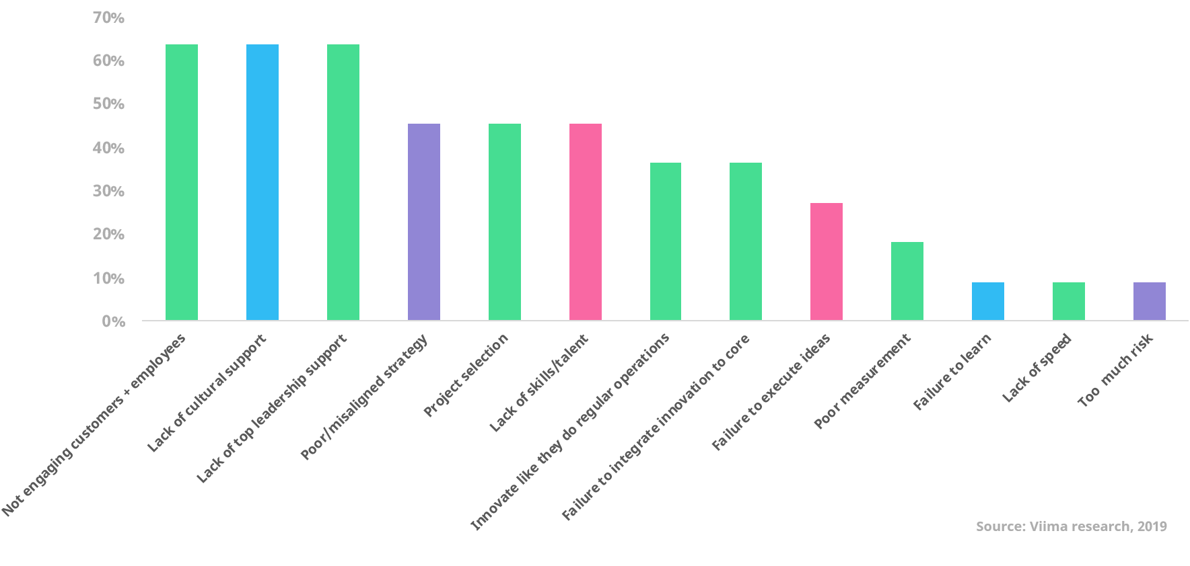

Slide 6
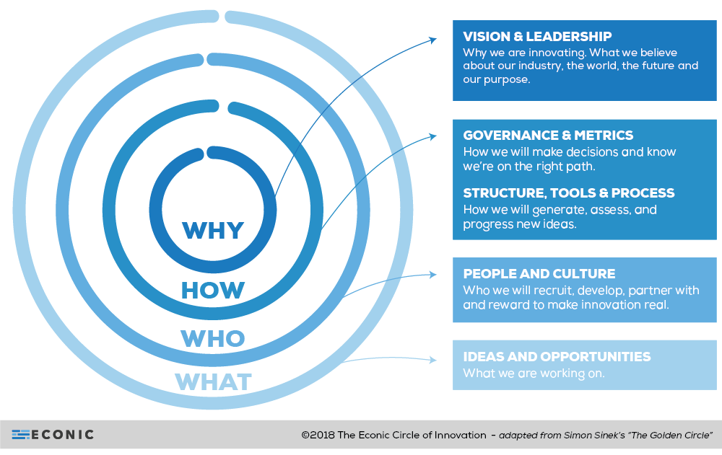

Slide 7
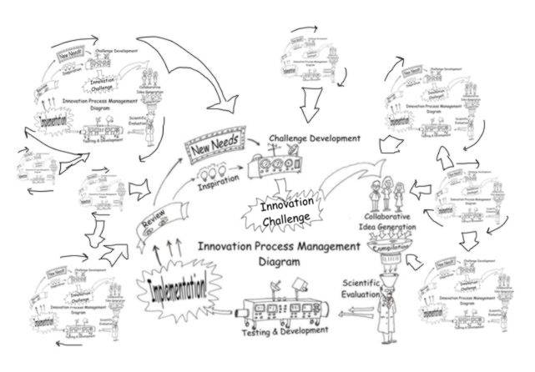
Why innovation is so difficult?
Source: https://www.creativejeffrey.com/creative/ipm.php

Slide 8
Almost 11 out of 12 start ups fail ….
What makes it harder is that most of startupers don’t have the courage or the ability to solve the problems before its too late.
Companies are not used in dealing with different innovation types – They prefer incremental innovations

Slide 9
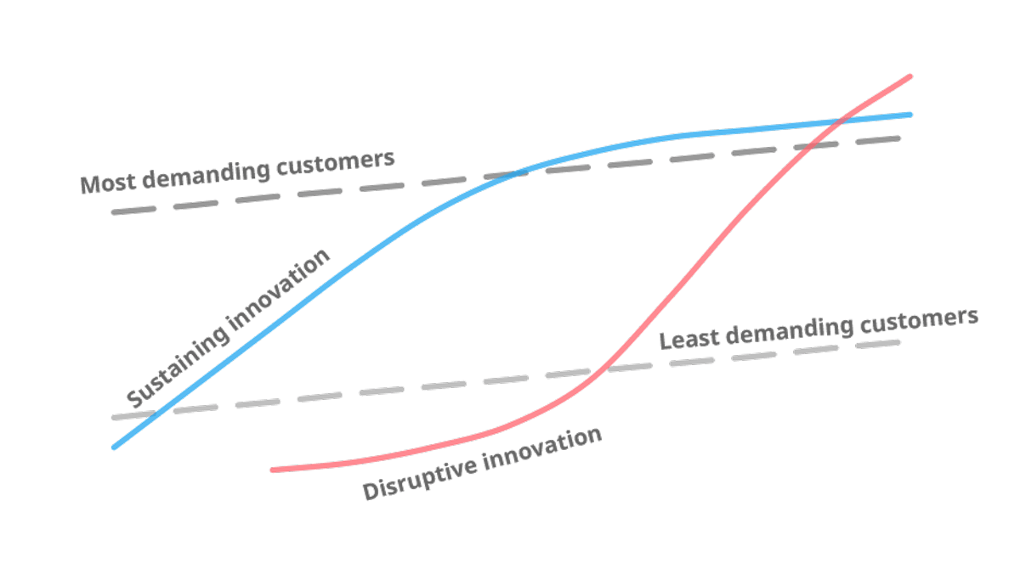
The dilema….

Slide 10

Ενσωματώστε την καινοτομία στον πυρήνα της επιχείρησης!
For an organization to be innovative there are many more things to do than just to open an R&D Department
It is not enough for innovation to do well in one sector / one department
We need the right strategy, structures, capacities and culture to innovate

Slide 11
How?
Design
Organise
Leadership
Control

Slide 12
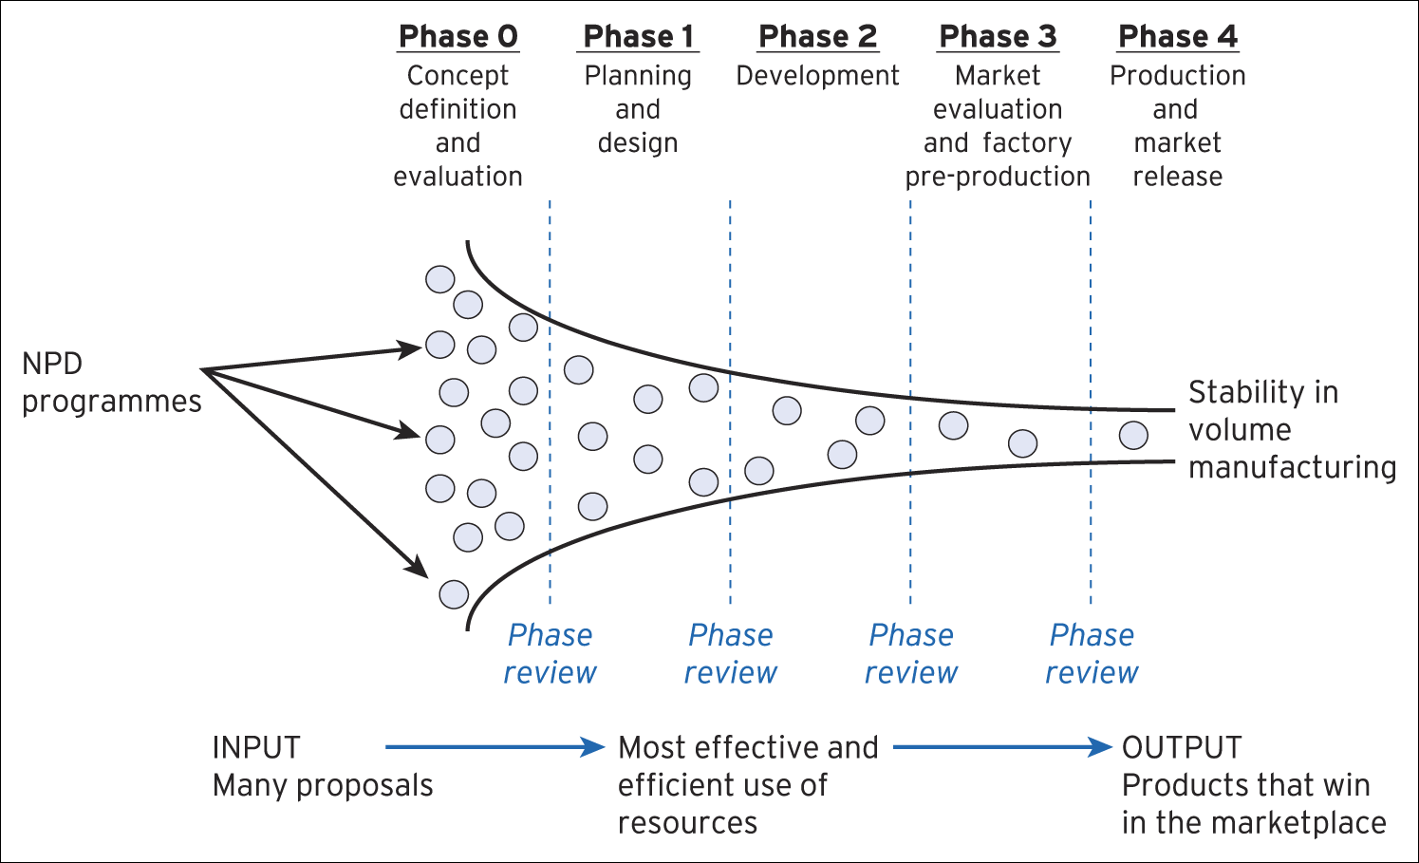
New product Development (NPD) The innovation funnel
12

Slide 13
Conditions favouring the development of innovations in organizations
Behaviours
Culture
Organization
The innovative organization
Leadership
Roles

Slide 14

Organization
How do we operate?
Who will we work with?
How can we get organized?

Slide 15
Organization
Innovation can be facilitated by:
A special mix of people with different backgrounds
Diversity of experiences / expertise
A range of different perspectives
Closed-knit groups
Absence of hierarchy
In business ideas there is equality
Absence of titles, symbols, status
Real connoisseurs are usually close to the action

Slide 16

Behaviours
What kind of behavior favors innovation?

Slide 17
Behaviours
Willingness to get out of the business and learn: Don't stay at your desk
Pleasure / Fun
Challenging fixed opinions (ie even the boss's)
Trial-and-error (i.e. experimentation)
Don't ask for permission, ask to be forgiven
The willingness to take risks

Slide 18
Culture
Company culture is usually unwritten rules and can best be described as follows:
"The way we do things around here"
"Shared values and beliefs"
The given assumptions that underpin the behaviour

Slide 19
Organizations with a culture of innovation
What do these organizations that are considered innovative have that others do not?

Slide 20

Culture of Innovation….
Extroversion and receptivity to the new and the different
Acceptance of failure
Challenging established perceptions
Promoting evaluation and reflection

Slide 21
Who?
Mediators
Champions
Gatekeepers
Contractors

Slide 22
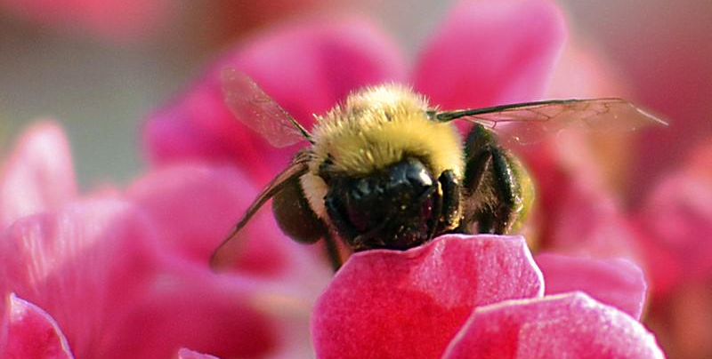
Mediators
They act as “go-between” groups and networks, e.g. accounting, product marketing, developers, etc.
The (intermediate) traders of information/knowledge
They can facilitate knowledge transfer

Slide 23
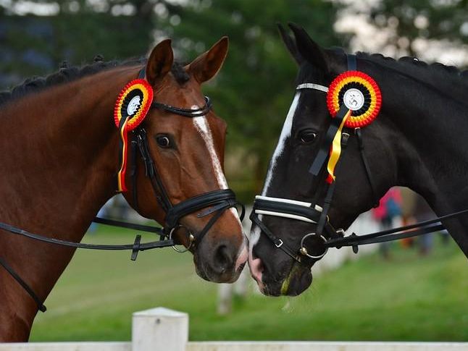
Product Champions
They promote and support innovation
Defining innovation - They attribute innovation through their experience
Innovation and project team protection
Providing political support within the business

Slide 24

Gatekeepers
They act as filters of information / knowledge - They accept or reject information
They tend to interact with each other
Act as 'uncertainty absorbers' - Draw conclusions in order to reduce uncertainty
They facilitate the transfer of knowledge

Slide 25
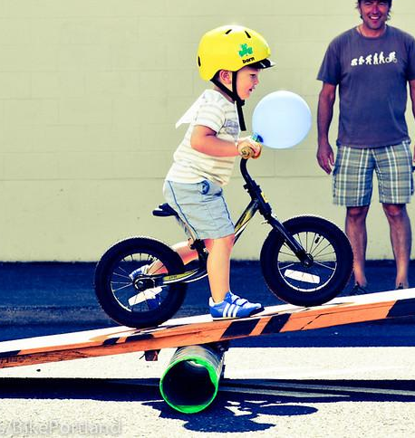
“step-parents”
An unofficial role
Usually someone who has a higher level in the organization
His role... "behind the scenes"
they "move the strings" to care for innovation
They provide moral support for the innovation team
They provide political support for innovation within the organization

Slide 26

Innovation leadership
It treats innovation as a survival / growth imperative
Effective innovation leadership needs:
  Targeting – exploring the space of innovation
  Philosophy - models and understanding of action plans
  Execution - creating favorable conditions for innovation
A moving target = constant review and learning
Innovation as a 'dynamic possibility' - responding to the challenge

Slide 27
The Innovative Organization
It has more to do with creating the necessary conditions to enable innovation to develop than with creating mechanisms, systems and controls
One size does not fit all – organizations need to adapt and develop what is right for them
Ideas must be mobilized - wherever they are
Innovation cannot be left to chance
Innovation is often more difficult in established large organizations
Conclusions

Slide 28

Most Innovative Organizations

Slide 29
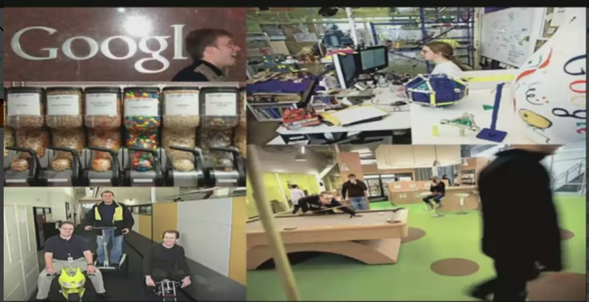
Google working space

Slide 30
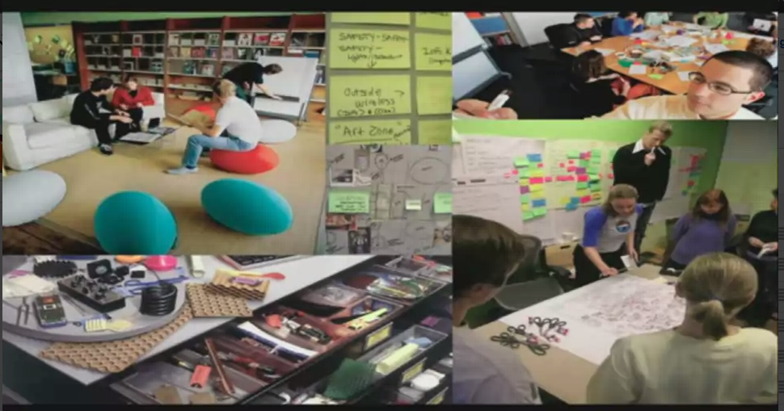
IDEO Working Space
IDEO Working Space

Slide 31
Д-р Параскеви Гиоурка
pgiourka@gmail.com
Thank you!

